Slide 1
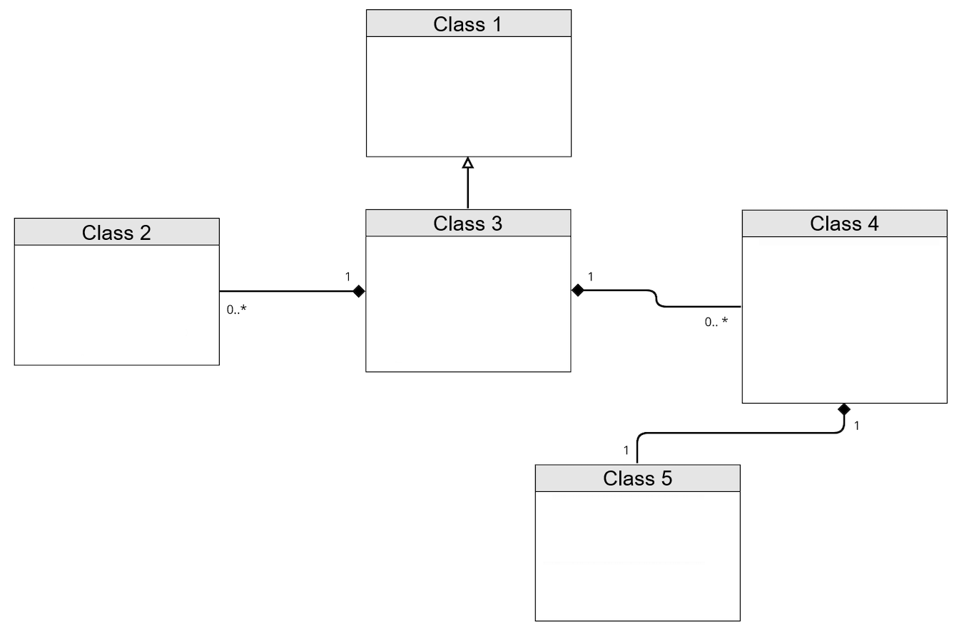
THE TITLE SHOULD BE PLACED AT THE TOP OF THE PAGE (36 pts)
YILDIZ TECHNICAL UNIVERSITY
FACULTY OF ELECTRICAL AND ELECTRONICS
DEPARTMENT OF ……………………
Student Full Name, Advisor Full Name (28 pts, bold, single line)
student1@std.yildiz.edu.tr, student2@std.yildiz.edu.tr, stundet3@std.yildiz.edu.tr, advisor@yildiz.edu.tr (24 pts)
The poster should be printed on A1 size paper.
Abstract (24 pts, bold)
(20 pts)
In this section, the contributions of the study, the motivation behind it, the main steps and the methods used in these steps and the outcomes obtained are briefly discussed. The abstract does not include any references and should be written with originality. Also, at the end of this section, keywords related to the study are provided. These keywords should be fundamental, significant, frequently used, and the most likely to come to mind during a search. Even if an abbreviation is used in the abstract, it should be redefined in the introduction section. The abstract section should consist of a maximum of 250 words
III. Results and Discussions
In this section, experimental or applied results obtained from the proposed methods for solving the problem addressed in the project study should be included. If your work is about developing an application, visuals that will introduce the various modules of this application from different angles should be included. If your study will be an experimental study, the findings of your research should be presented objectively and clearly in the Experimental Results section, in other words, both the superior and weak results of the findings should be included together.
In summary, the following should be included in the Experimental Results section:
Summary of your data: Your data should be summarized using visuals such as tables, graphs and diagrams.
Statistical analyses: The statistical methods and results you used to analyze your data should be described.
Main findings: Highlight the most important findings of your research and present the data that support them.
Comparisons with expectations: Your findings should be compared with your predetermined hypotheses or the results of other research, including explanations for unexpected results.
The Practice Implications section explains what your findings mean in the broader context and what implications they have for practical applications. In this section you should include:
Significance of your findings: Explain why the findings of your research are important and what contributions they make.
Practical applications: Discuss in which areas your findings may have practical applications and how these applications can be realized.
I. Introduction
The introduction should include sufficient basic information so that the reader can understand the topic and evaluate the purpose of the project and how it contributes to the topic. For this purpose, the subject of the project should be defined and the purpose and target of the study should be briefly explained. Motivation of the project; In other words, the reason why this topic was chosen and why the topic is important should be well emphasized in the introduction.
By briefly mentioning and citing the studies conducted on the subject, an explanation should be made as to which gap in the literature the subject under study closes and which problem it solves.
II. Materials and Methods
This is the section where you explain the technical details of the system you propose. This section gives readers an understanding of how your system works, what components it consists of, what methods are used, and how these components interact. The operation of the system should be visualized with data flow and process flow diagrams. This section should be consistent with the rest of the poster and should be written carefully to help readers understand the system-architecture.
Conclusion
The results section is the section where the results obtained from the study are evaluated. The procedures carried out within the scope of the study are briefly summarized and the results are interpreted. If several methods are used and compared, it is stated which method is the most successful. Suggestions can be given for future studies.
Limitations: State the limitations of your research and factors that may affect the generalizability of your findings.
Suggestions for future research: Based on the findings of your research, make suggestions about what areas of research should be investigated in the future.
A. Figure Table, Equation and Algorithm (20 point)
Figure captions should be at the bottom and table captions should be at the top. Table and figure captions should not be too short or too long. Added figures, tables, equations and algorithms must be referred to as "Equation 1." or “Algorithm 1in the text.
Figure 1. Figure title(20 pts)
Figure 3 Figure title.
(1)
References
References must be in APA format and written in 16 pts. References include website etc. Simple resources such as these should not be given unless absolutely necessary. Indexed journal articles and distinguished conference proceedings in the literature related to the study subject should be scanned.
While references are given in the text, they should be given in the correct order from smallest to largest.
When giving references as [1], [2] in the text, a space must be left before it. Additionally, if the reference is at the end of the sentence, the end of the sentence should be placed after the reference.
Even if a reference is given when quoting the main source, it should not be copied verbatim. A numerical result or cases where it is not possible to change are excluded.
Old references can be given for basic information about the study, but in general, referencing more recent publications will reveal that the person is doing active research.
Before citing publications that have not yet been published, such as Arxiv, it should be checked whether that publication has been published or not. If the publication is in print, the published version, not the archive version, should be referenced.
Example References:
[1] Author's Surname, First Letter of Author's First Name. (Year). Title of the Source. Publisher or Journal, volume (issue), pages.
[2] Author's Last Name, Author's First Initial. (Year). Title of the Source. (Year). Publisher or Journal, volume(issue), pages.
Table 1. Table title. (20 pts)
 | X | Y | Z
x
y
z
Algorithm 1. Simple Algorithm
1: | i ← 10
2: | if i ≥ 5 then
3: | i ← i - 1
4: | else
5: | if i ≤ 3 then
6: | i ← i + 2
7: | end if
8: | end if

